Slide 1
Module 3 - Connectors

Slide 2
Introduction
Connecting to wide variety of devices and data sources is a key feature of SkySpark.
The following slides explore what it looks like to get data into SkySpark from an end device.
Once data is in SkySpark, hundreds of functions can be combined to accomplish virtually any task.

Slide 3
SkySpark Connector Framework
The Connector Framework standardizes the workflows for integration to remote systems.
A Connector (conn) record models a logical connection to a remote system.
The primary purpose of a Connector is to model remote I/O points in the local project as proxy points.
Connector Framework Documentation: https://skyfoundry.com/doc/ext-conn/doc#overview

Slide 4
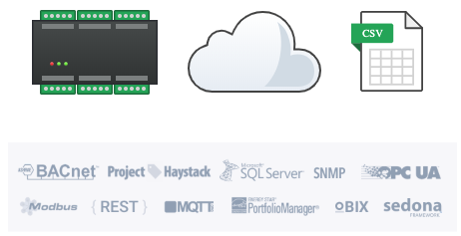
Protocols
A protocol is the language that a device speaks and SkySpark can speak the same language using a Connector.
SkySpark can connect to several protocols including:
Bacnet IP
Haystack
Modbus TCP
OPC UA
Sedona
SNMP
SQL via JDBC
MQTT

Slide 5
Setting up a Haystack Connector

Slide 6

Haystack REST API
Connector
Haystack is not simply an industry standard for applying meaning to data from the Internet of Things.
Project Haystack also defines a REST API, which is a simple mechanism to exchange haystack tagged data over HTTP.
Each SkySpark host is also a Haystack server allowing data to be accessed using the same open REST API.
The SkySpark Haystack Connector is a Haystack client that can connect to Haystack servers.
SkySpark REST API Documentation: https://skyfoundry.com/doc/docSkySpark/Rest

Slide 7
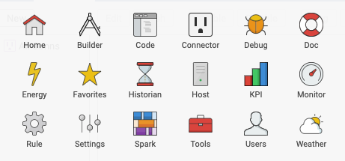
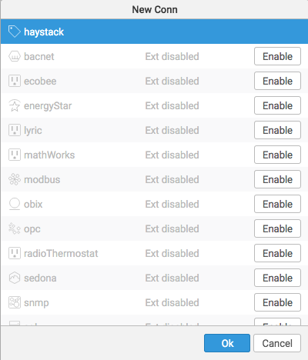
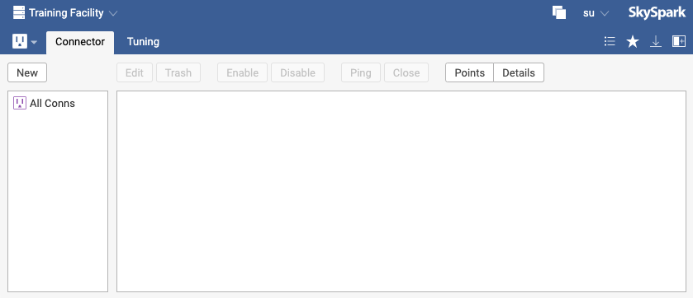
Adding a Connector to a Project
Connector
1
Go to the Connector app in the Training project.
Click the New button.
Click the Enable button next to haystack (SkySpark can both send and receive data using this protocol). Haystack will move to the top of the list.
Click Ok.
3
2
4

Slide 8
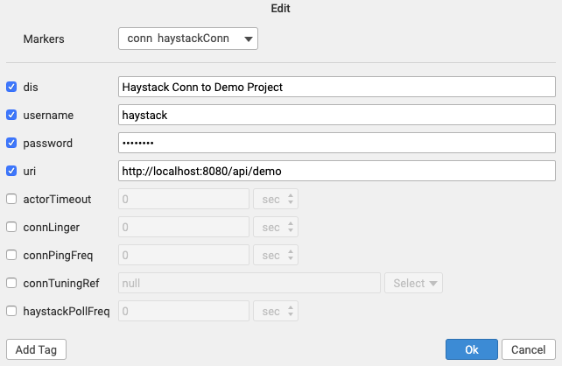
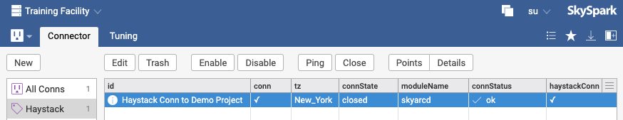
Configuring SkySpark Connector
Connector
Enter the Connector details:
dis: Haystack Conn to Demo Project
username: haystack
password: testpass
uri: http://localhost:8080/api/demo
Click Ok.
Select the new connector (conn) record and click Ping.
Scroll to verify the connStatus tag has a value of ok.
1
2
3

Slide 9

Best Practices for Haystack Connectors
Builder
When setting up Haystack Connectors, use HTTPS connections when available (https instead of http in the uri).
When pinging an HTTPS connection, if SkySpark reports a javax.net.ssl.SSLHandshakeException then SkySpark doesn’t trust the connection.
In this case, go to the Host app Crypto view, click the Trust Uri button and enter the uri from the Haystack connector along with a unique alias (such as [deviceName]HaystackHttps) then click Ok.
When troubleshooting a Haystack connection, try using the /about path.
https://address:port/haystack/about
https://skysparkHost:port/api/[project]/about
Haystack Connector Documentation: https://skyfoundry.com/doc/ext-haystack/doc#overview

Slide 10
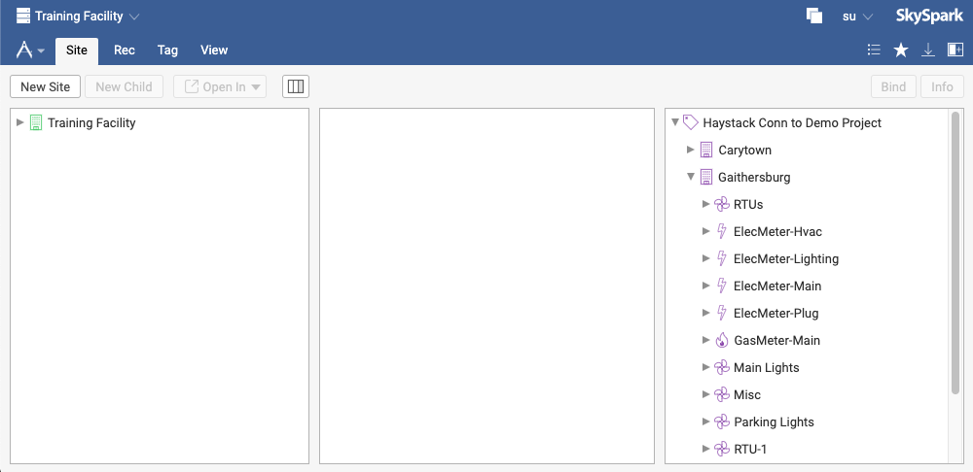
Introducing the Connector Tree
Builder
Go to the Builder app and Site tab.
Click the arrow to expand the connector tree to view the remote data model.
1
2

Slide 11
Binding Remote Data Sources to Local Points

Slide 12
Defining the project data model
Builder
When connecting to a remote system, consider the data model in the local project.
When connecting to a Haystack server using the Haystack Connector, the remote data model will be shown assuming the remote system is following standard Haystack tagging conventions.
Most other protocols won’t have a standard way of displaying a data model, so the data model needs to be setup in the local project prior to connecting to the remote system.

Slide 13
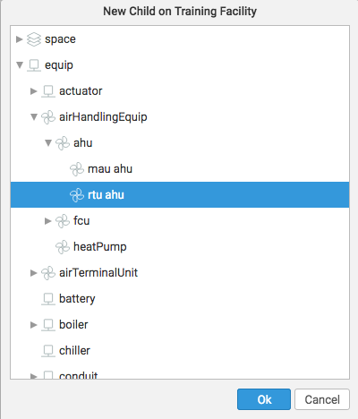
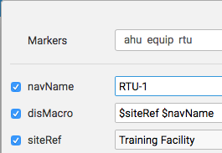
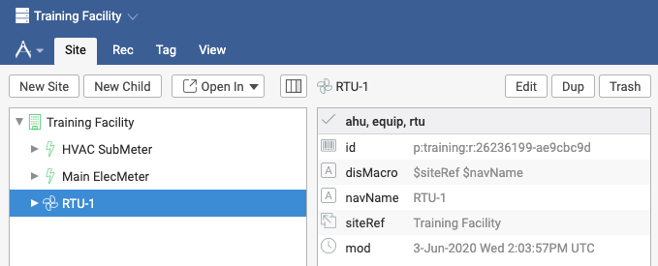
Create a local SkySpark equip record
Builder
Click on Training Facility.
Click on New Child.
Expand equip => airHandlingEquip => ahu => rtu ahu
Click Ok.
Change the navName to RTU-1.
Click Ok.
Expand the Training Facility by clicking on the triangle.
Click on RTU-1.
Continue to next slide.
3
5
4
7
8

Slide 14
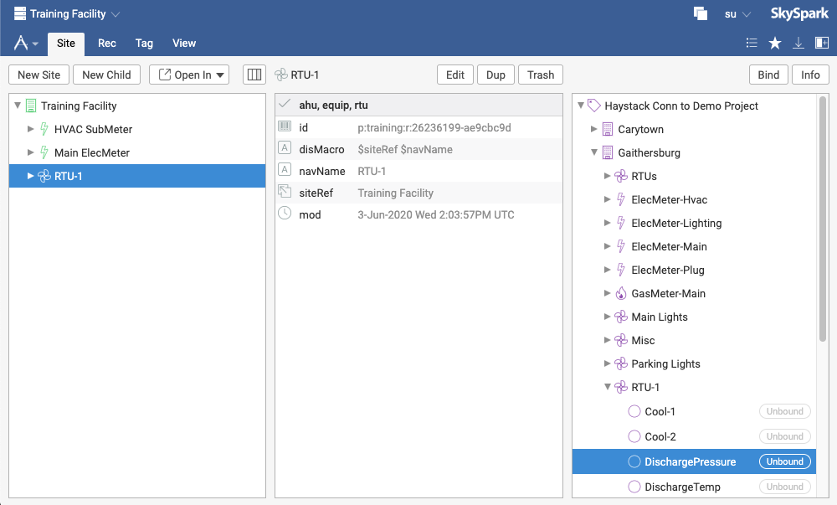
Bind Remote point to local SkySpark project
Builder
Expand the connector.
Expand Gaithersburg.
Expand RTU-1.
Click on DischargePressure.
Click Bind.
Continue to next slide.
5
1
2
Must have a destination record selected in the nav tree for the Bind button to be active
It is also possible to drag the DischargePressure point from the Connector tree and drop it directly on the nav tree (left column) or the details pane (middle column).
3
Selecting multiple points in the Connector tree and dragging and dropping them on an equip record will bring up the multi-bind dialog.
4

Slide 15
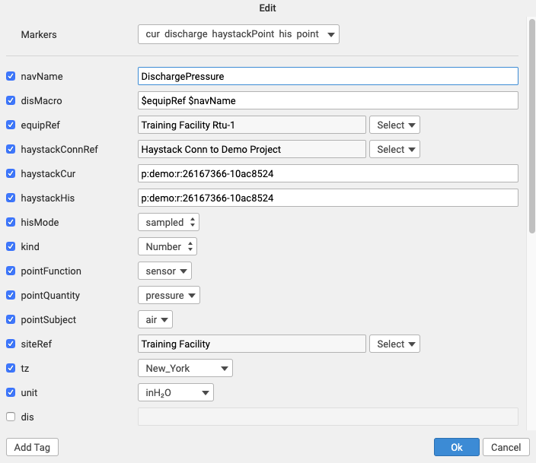
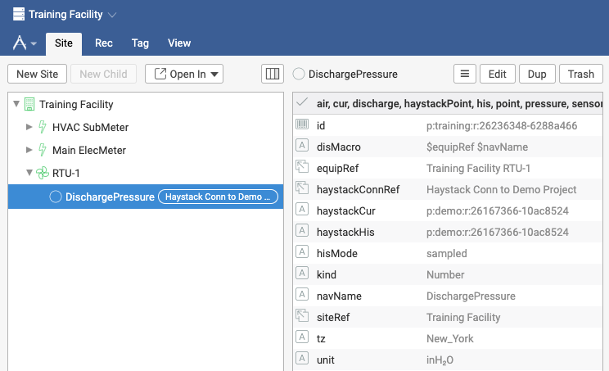
Automatically Create local SkySpark point
1
Builder
The Edit Record dialog appears with all the tags that will be added to the new local point record automatically.
Click Ok.
Expand RTU-1.
Click on DischargePressure.
Continue to next exercise.
3
4
The new point records equipRef is automatically added.
If a local point record already exists, select the local point record first and then click Bind to update the existing point.
2

Slide 16
Syncing Historical Data

Slide 17
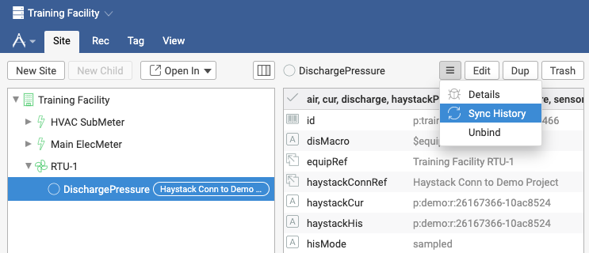
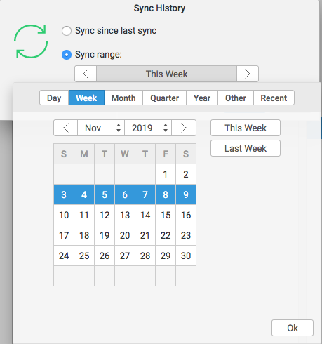
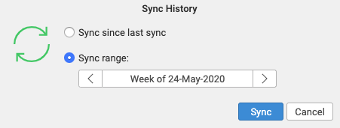
Syncing History from Remote Device
Connector
Builder
Click on the three horizontal lines (hamburger) button.
Select Sync History.
Select Sync range of lastMonth.
Click Sync.
1
2
3
Sync since last sync may not work properly since there was no last sync (this point in the Training project has never had history) and the request to the remote device could timeout.
4

Slide 18

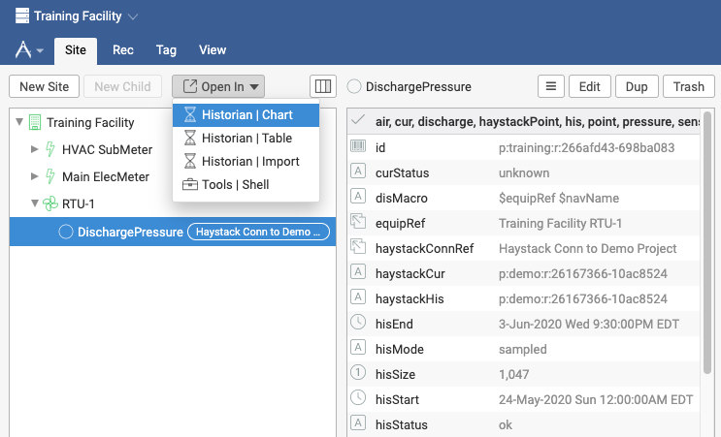
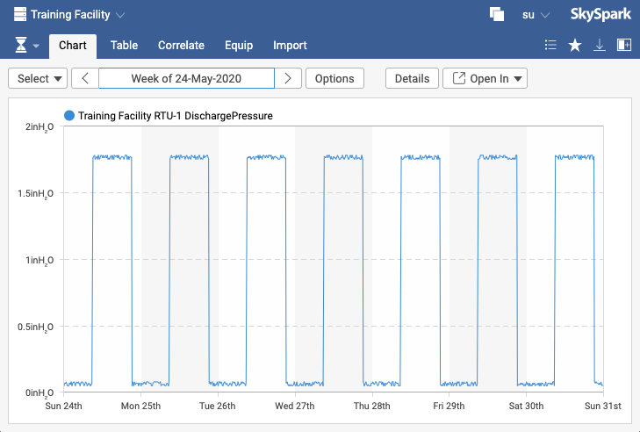
Viewing Historical Data
Historian
With the DischargePressure point still selected, navigate to the Historian app by clicking the Open In menu.
Select Historian | Chart.
Select lastWeek in the span.
1
2
3
Notice, the hisEnd, hisSize, hisStart and hisStatus tags get added to the point record after the sync history action.

Slide 19
Synching Histories with a Connector
If a remote device has local storage and the protocol supports synching historical data, SkySpark can automatically collect that data after performing an initial sync – remember the Weather Station in Module 2
Sync is protocol specific:
<ConnRecord>.obixSyncHis(pastWeek)
<ConnRecord>.haystackSyncHis(pastWeek)
<ConnRecord>.bacnetSyncHis(pastWeek)
<ConnRecord>.sqlSyncHis(pastWeek)
Use the Job App to schedule your syncs:
<ConnRecord>.obixSyncHis(null)
<ConnRecord>.haystackSyncHis(null)
<ConnRecord>.bacnetSyncHis(null)
<ConnRecord>.sqlSyncHis(null)
Initial sync needs to have a finite time range, such as pastWeek…anything but null
Scheduled sync needs to have null time range to avoid his out-of-order warnings and handle times where network or device issues caused the sync to fail

Slide 20
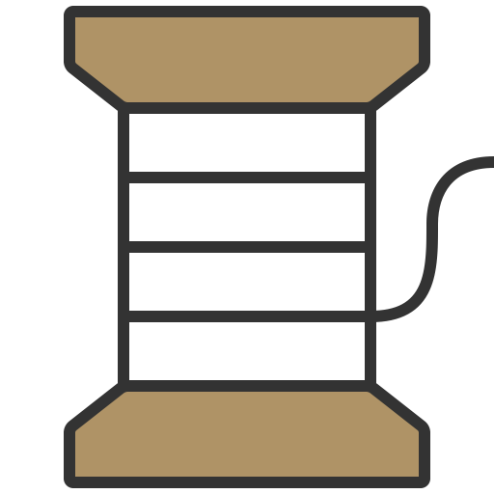
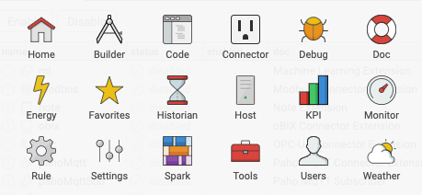
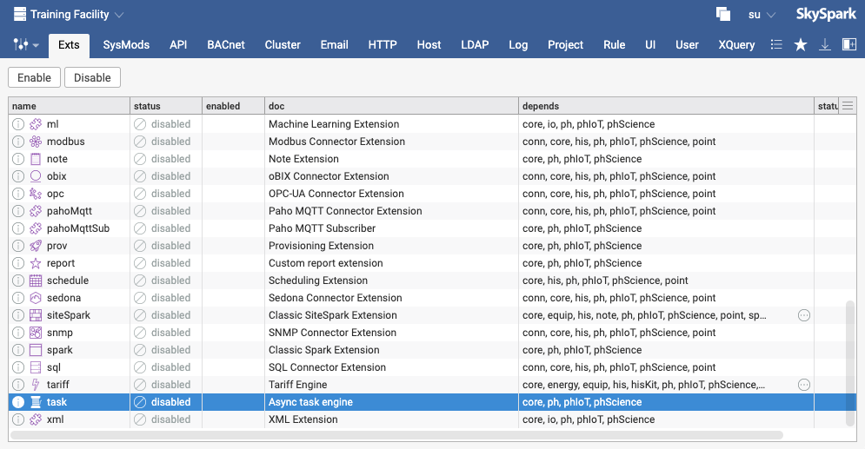
Enable Task Ext to Automate History Sync
Task
Navigate to the Settings app Ext view.
Click the Task ext.
Click the Enable button.
Continue to the next slide.
1
3
2

Slide 21
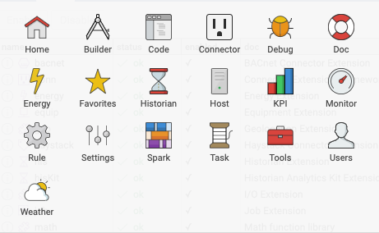
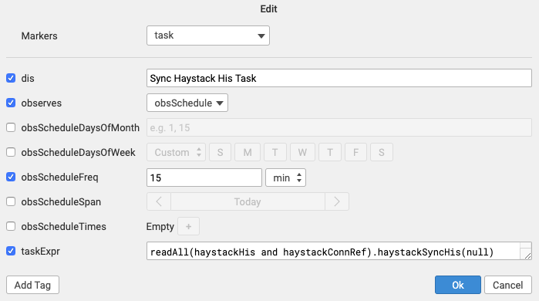
Creating a Task to Automate History Sync
Task
Navigate to the Task app.
Click the New button.
Create the task shown in the screenshot.
dis: Sync Haystack His Task
observes: obsSchedule
obsScheduleFreq: 15min
Enter the Axon expression shown for the taskExpr.
Click Ok.
1
3
The frequency that the task runs is dependent on the application and device so a less frequent period, such as 24 hours or every day at 2am is more commonly used and recommended.
4
5
readAll(haystackHis and haystackConnRef).haystackSyncHis(null)

Slide 22

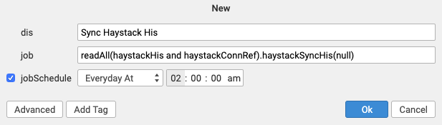
Creating a Job to Automate History Sync
Tools
Prior to SkySpark 3.0.25, Jobs were used to automate the history sync process.
Tasks are preferred moving forward, but in older versions, use the Tools app Job view to create and schedule the history sync.
readAll(haystackHis and haystackConnRef).haystackSyncHis(null)

Slide 23
Trending in SkySpark

Slide 24
Trending (Live Collection)
Trending is configured by adding tags to a point record.
Using haystack as an example:
his (to hold history)
cur (identifies a real-time point)
haystackConnRef (ref / id points to connector)
haystackCur (string that points to a foreign address)
hisCollectInterval: 15min (where 15min is the desired collection interval)
hisCollectCov (marker tag or numeric tolerance)
No initial syncing is required.
Note that the curVal will change and the collect comes from the curVal (do not expect each curVal that is displayed to be logged – this depends on the collection frequency).

Slide 25
Best Practices for Collecting History
When using a central SkySpark server architecture with SkySpark primarily located in a data center or the cloud:
Perform trending in the Building Automation System (BAS) server, not in SkySpark whenever possible.
Have SkySpark sync the historical data periodically from the BAS. Only sync to the edge controllers or devices if syncing to the BAS is not possible.
Configure the history sync as infrequently as possible – syncing every 15 minutes is going to require a lot more I/O and CPU than once every 24 hours.
When using a distributed SkySpark architecture:
Trending on the SkySpark server, using the hisCollectCov or hisCollectInterval tags, may be more common since SkySpark is much closer to the data source.
Leverage SkySpark clustering to centrally view data and analytic results across all SkySpark nodes.
Configure SkySpark replication to create backups of distributed projects as infrequently as possible.

Slide 26
Debugging Connectors

Slide 27
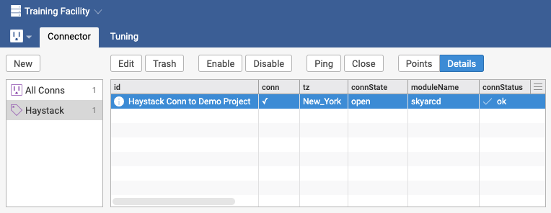
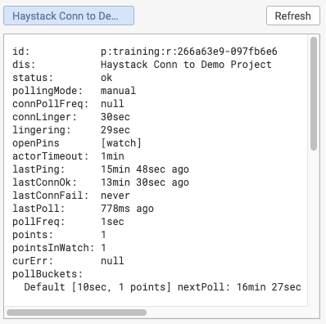
Connector Details
Connector
Go to the Connector app.
Click on the Haystack conn record.
Click on Details.
Check connStatus.
down is communication err
fault is config err
Check connState.
closed if no points are watched
Check Other Details:
connLinger - How long conn has lingered
lastConnOk - Last time with ok status
lastConnFail – Last time of failure
lastPoll – Last time poll took place
3
5
4
2
6

Slide 28
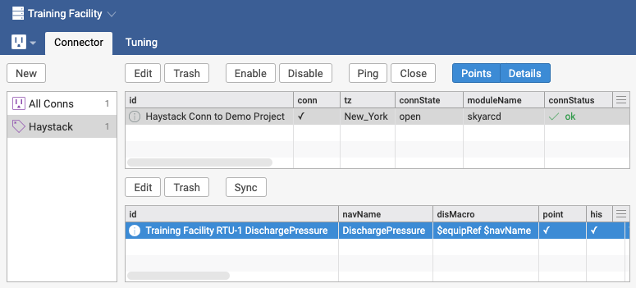
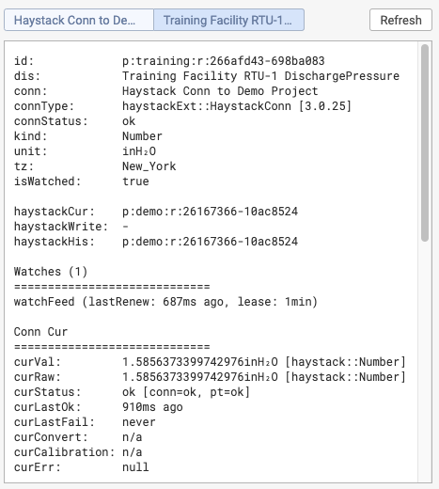
Point Details
Connector
Click on Points and Details.
Click on the DischargePressure point record in the bottom pane.
Check curStatus.
A point will inherit the status of its connector
Next slide explains curStatus values
Check Other Details:
isWatched – a point with a curVal should be watched if history is collected locally
Cannot collect history if curStatus != “ok”
Vals vs Raw Vals can identify protocol conversion issues
1
2
3

Slide 29
Point Details curStatus Values
Connector
ok: all is okay
stale: the point's curVal is not fresh data
fault: a configuration problem - see curErr
down: a communication or network problem - see curErr
disabled: manual disable of the point or parent connector
unknown: we don't know anything (usually boot state)
remoteFault: point in remote system is fault
remoteDown: point in remote system is down
remoteDisabled: point in remote system is disabled
remoteUnknown: point in remote system is unknown

Slide 30
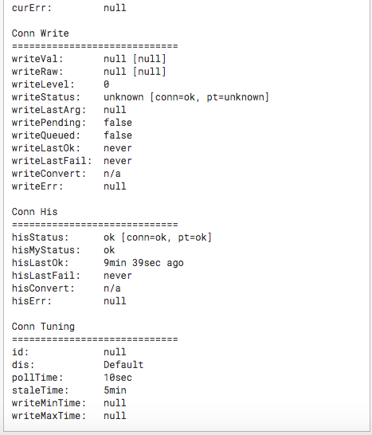
Additional Point Details
Connector
Conn Tuning discussed on next slide.
Note that an UNKNOWN_OBJECT error means the address to the remote device is wrong.
Also note that: sys::IOErr: java.net.ConnectException: Connection timed out: connect always means there is no connectivity to the remote system (usually networking or addressing problem)
Could not read from socket. No data received is always a network error. It could be a forwarding error if using port forwarding.

Slide 31
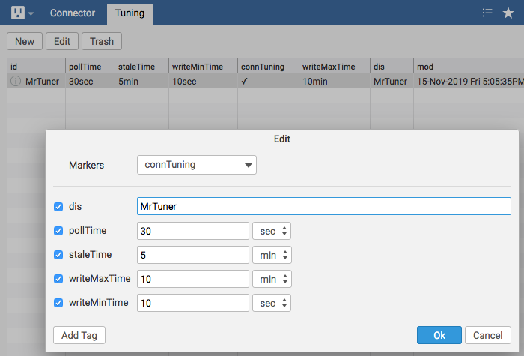
Tuning Manager
Connector
Manage connector behavior.
A tuning record has the connTuning tag.
A connTuningRef tag may be applied to a point if all points don’t need the same changes.
pollTime – Frequency for polls. Default is 10sec.
staleTime – When a curVal is considered old -> no longer “ok”.
Connector Tuning Documentation: https://skyfoundry.com/doc/ext-conn/doc#tuning

Slide 32
BACnet Connector Example

Slide 33

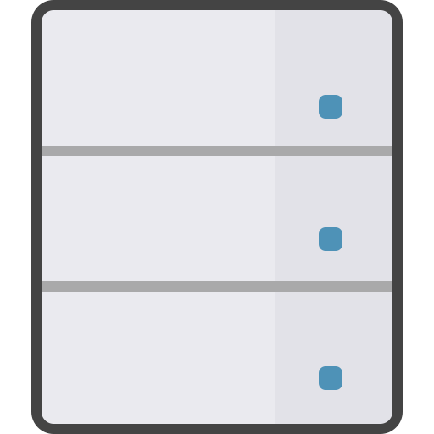
Connecting SkySpark to BACnet Devices
SkySpark can connect directly to a BACnet IP device.
SkySpark can also connect to any other BACnet protocol through a BACnet IP Gateway.
DEVICE_ID
IP_ADDR:PORT
SkySpark
BACnet IP
uri: `bacnet://IP_ADDR:PORT/DEVICE_ID`
DEVICE_ID
MAC_ADDR
IP_ADDR:PORT
NET_ID
SkySpark
BACnet IP Gateway
BACnet MSTP, BACnet Ethernet, or ARCNET
uri: `bacnet://IP_ADDR:PORT/DEVICE_ID?dnet=NET_ID&dadr=MAC_ADDR`

Slide 34
BACnet Connector Overview
The BACnet protocol includes a device discovery capability that can simplify setting up connectors.
The BACnet IP protocol uses UDP as its transport protocol. UDP does not guarantee delivery like TCP. Busy networks could have dropped messages.
The Discovery mechanism leverages a UDP broadcast packet, which may not work across large networks. If device discovery doesn’t find any devices, it may be necessary to set up the connectors manually.
BACnet Connector Documentation: https://skyfoundry.com/doc/ext-bacnet/doc#overview

Slide 35
Discovering and Binding to BACnet IP device points

Slide 36

Monitor App

Slide 37
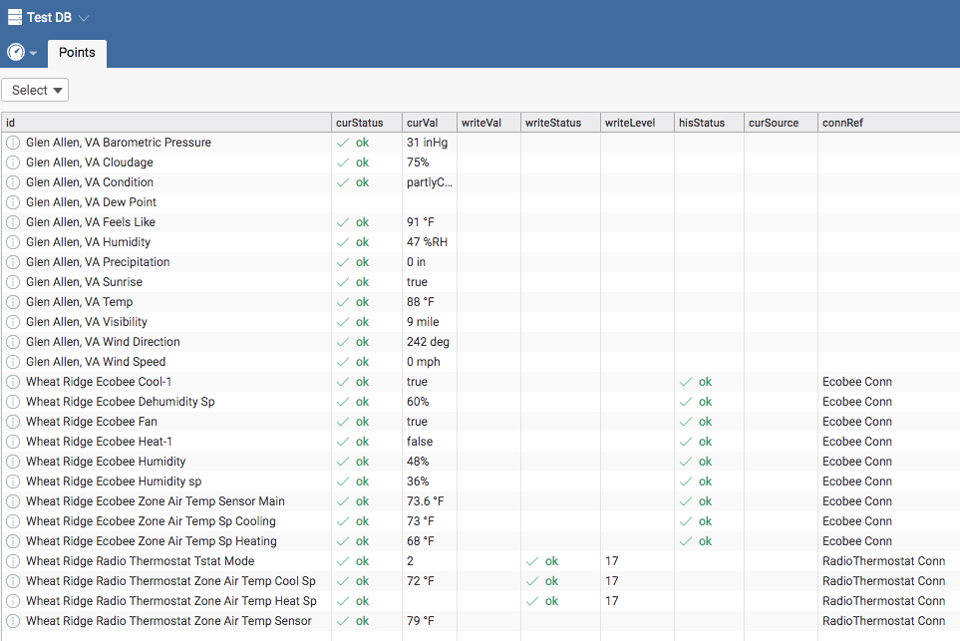
Monitor App
Monitor
Go to the Monitor app.
Add point records to view curVal updates.
Connectors
Weather

Slide 38
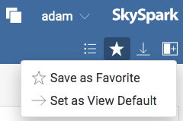
Configure Default View for Monitor App
Monitor
After adding points to the Monitor app, click the star in the upper right-hand part of the screen to open the Favorites menu.
Select Set as View Default.
Open a different app, then open the Monitor app again to see the previously configured points are displayed by default.

Slide 39
End of Module 3

